Slide 1
CSE115
Lecture 14
Dr. Mohammad Abu Yousuf (MAY)

Slide 2
ARRAYS OF POINTERS
A multidimensional array can be expressed in terms of an array of pointers rather than a pointer to a group of contiguous arrays. In such situations the newly defined array will have one less dimension than the original multidimensional array. Each pointer will indicate the beginning of a separate (n- 1)-dimensional array.
In general terms, a two-dimensional array can be defined as a one-dimensional array of pointers by writing
data - type *array[expression 1] ;
rather than the conventional array definition,
data- type array[ expression 1] [ expression 2] ;

Slide 3
Example:
Suppose x is a two-dimensional integer array having 10 rows and 20 columns.
We can define x as a one-dimensional array of pointers by writing
int * x [10] ;
Hence, x[0] points to the beginning of the first row, x[1] points to the beginning of the second row, and so on. Note that the number of elements within each row is not explicitly specified.

Slide 4
An individual array element, such as x[2] [5], can be accessed by writing
*(x[2] + 5)
In this expression, x [2] is a pointer to the first element in row 2, so that (x [ 2] + 5) points to element 5 (actually, the sixth element) within row 2. The object of this pointer, *(x [ 2 ] + 5) , therefore refers to x[2] [5].

Slide 5
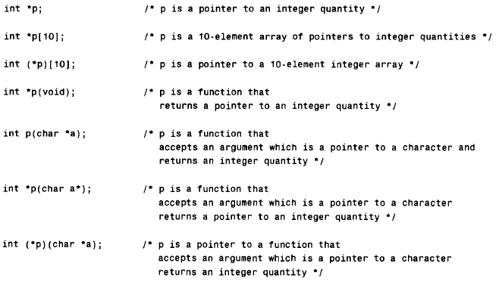

Slide 6
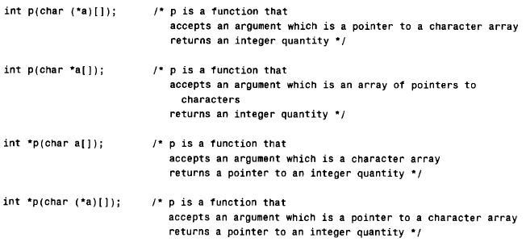

Slide 7
Structure

Slide 8
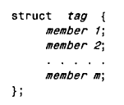
DEFINING A STRUCTURE
In this declaration, struct is a required keyword; tag is a name that identifies structures of this type (i.e., structures having this composition); and member 1 , member 2, . . . , member m are individual member declarations.

Slide 9
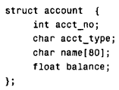
Example
We can now declare the structure variables oldcustomer and newcustomer as follows.
struct account oldcustomer, newcustomer;
Thus, oldcustomer and newcustomer are variables of type account.

Slide 10
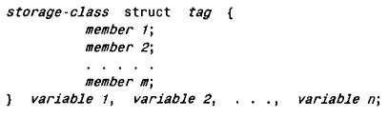
It is possible to combine the declaration of the structure composition with that of the structure variables, as shown below.
The tag is optional in this situation.

Slide 11
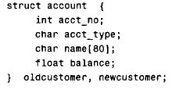
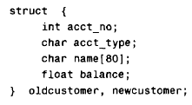
The above declaration can also be written as

Slide 12
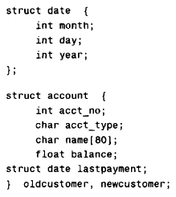
A structure variable may be defined as a member of another structure. In such situations, the declaration of the embedded structure must appear before the declaration of the outer structure.

Slide 13
The second structure (account) now contains another structure (date) as one of its members. Note that the declaration of date precedes the declaration of account.

Slide 14
The members of a structure variable can be assigned initial values in much the same manner as the elements of an array. The initial values must appear in the order in which they will be assigned to their corresponding structure members, enclosed in braces and separated by commas. The general form is
struct tag variable = {value 1, value 2, . . ., value n);
where value1 refers to the value of the first member, value 2 refers to the value of the second member, and so on.

Slide 15

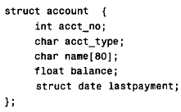
struct account_customer = (12345, ' R I , "John W. Smith", 586.30, 5, 24, 90);

Slide 16
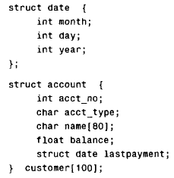
It is also possible to define an array of structures

Slide 17
PROCESSING A STRUCTURE
A structure member can be accessed by writing
variable. member
where variable refers to-the name of a structure-type variable, and member refers to the name of a member within the structure.

Slide 18
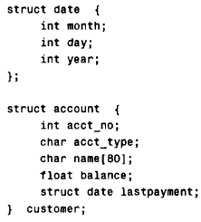
customer.acct_no

